Slide 1
Food Forecasting Project Dashboard-Story

Slide 2
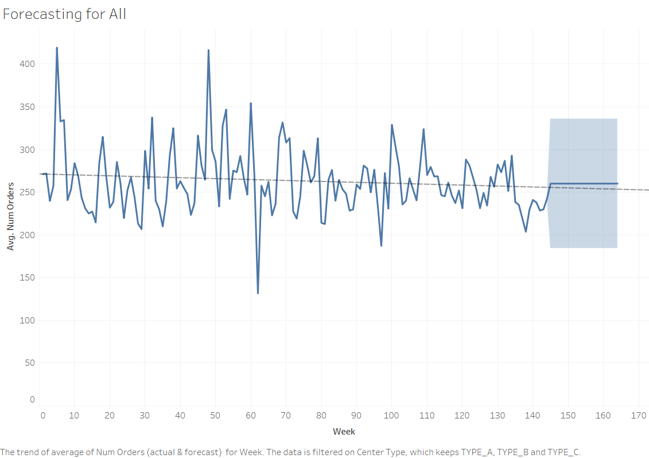

Slide 3
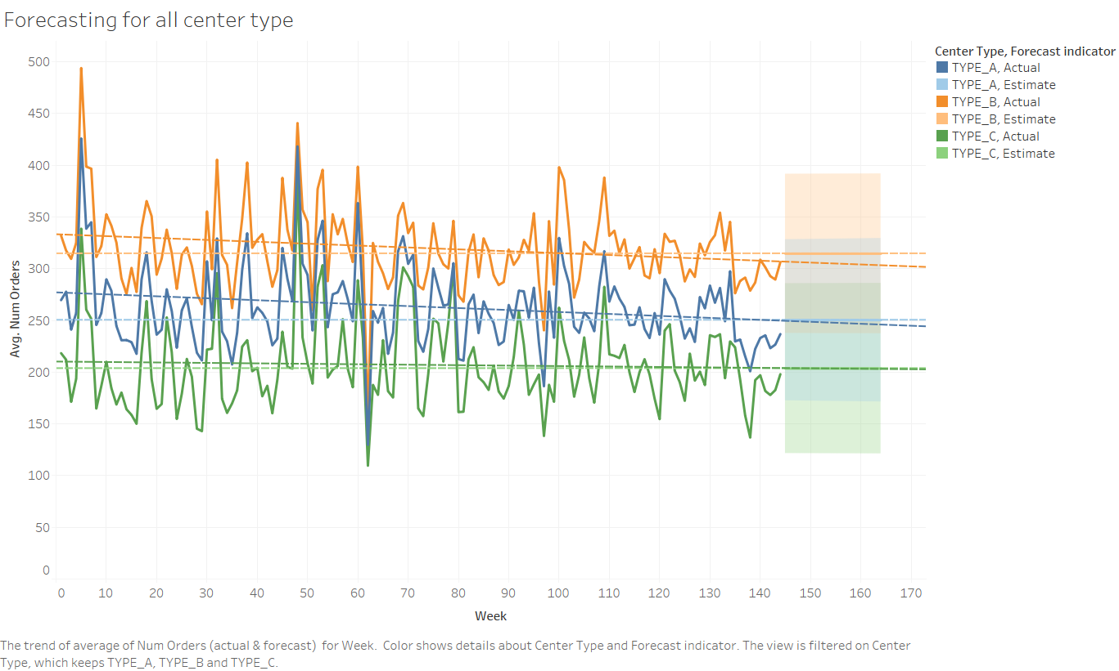

Slide 4
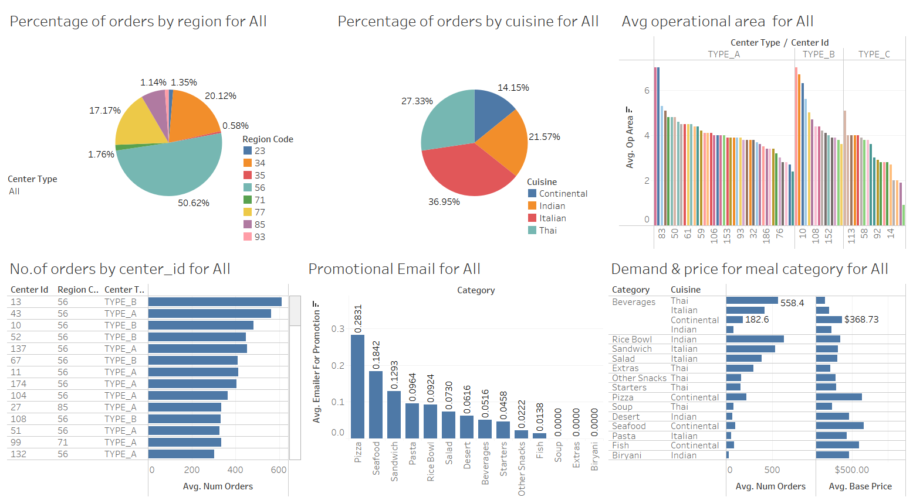

Slide 5
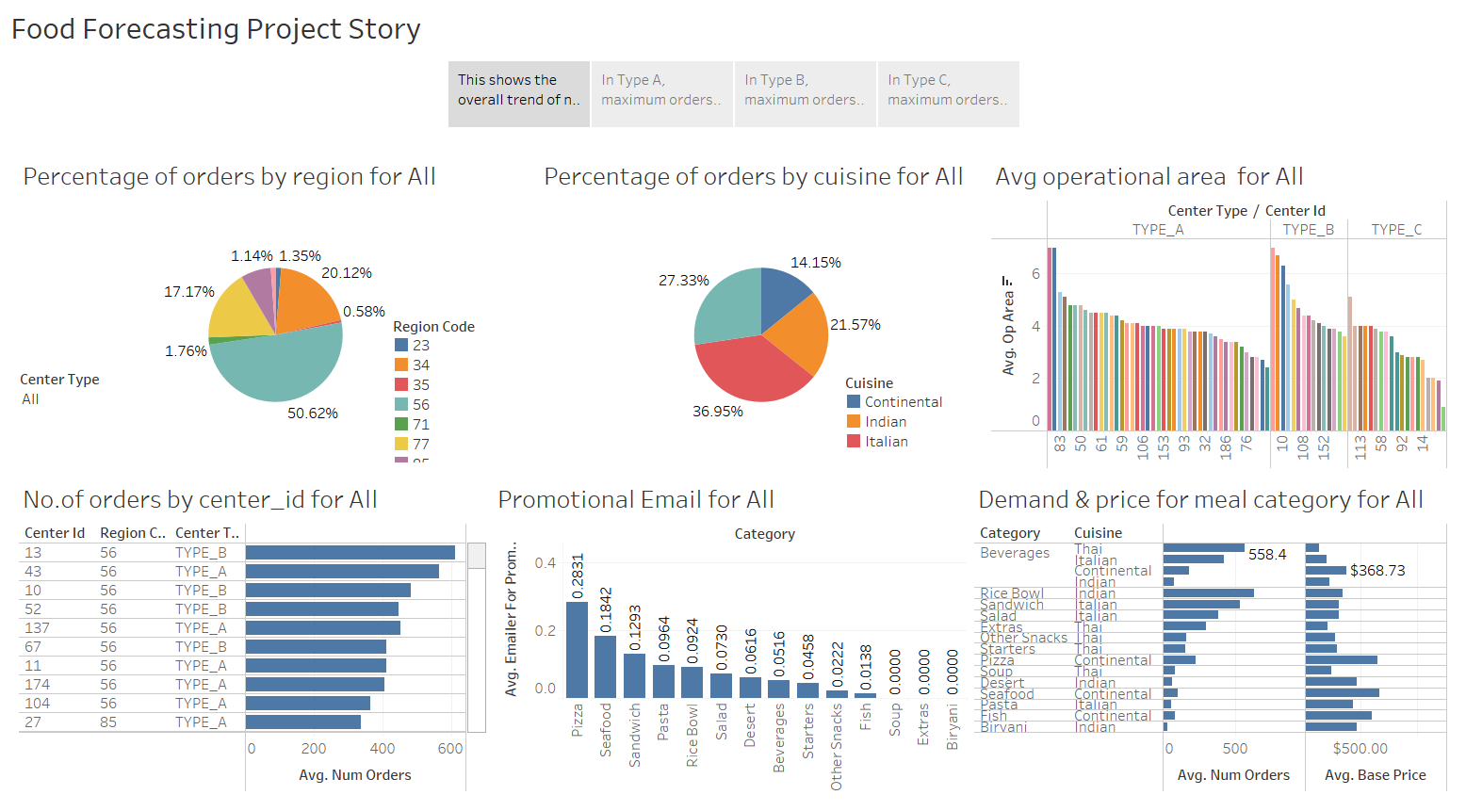

Slide 6
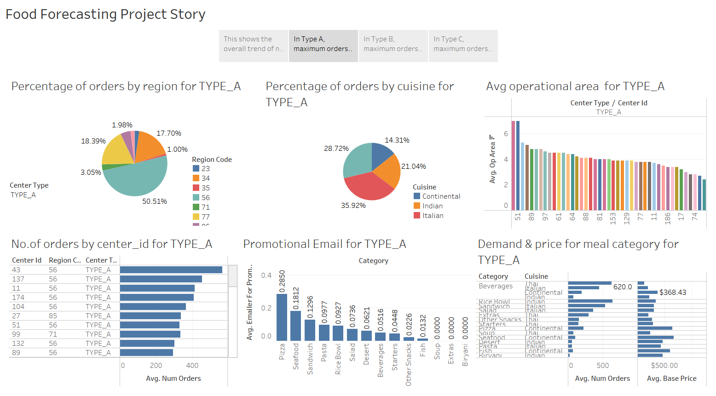

Slide 7
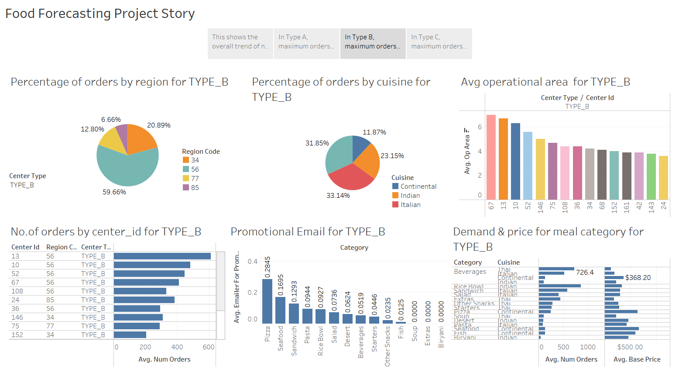

Slide 8
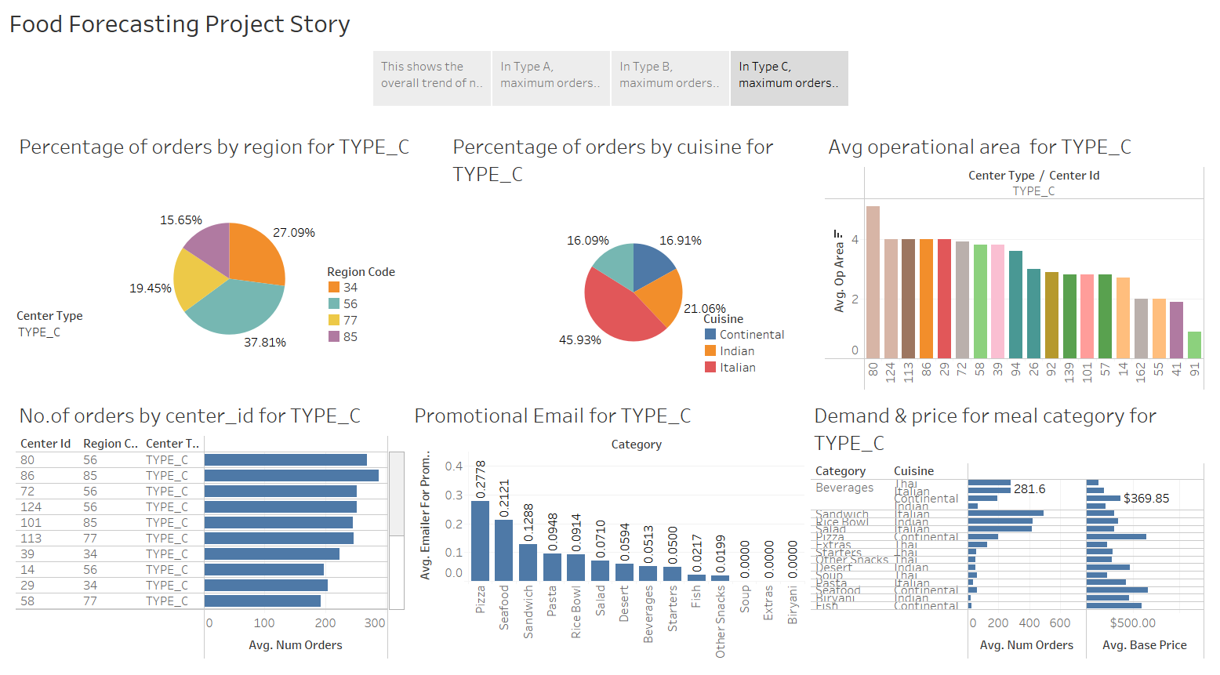

Slide 9
Story Captions for the Food Forecasting Project
The overall trend of number of orders shows, Type B and A doing well, as compared to Type C, in terms of placing more number of orders.
More number of orders are estimated to be placed from Type B, than A and C, as seen from forecasting plot in page 3.
Center_id: 13,43,137,11,174,104 are overall doing good, in terms of average number of orders. While, 41 and 91 is placing a few orders only. The promotional email for Pizza and seafood has been the largest, but number of orders placed for Pizza and seafood are less, due to its high price. Overall, the price of continental items are higher, which should be reduced.
In Type A, maximum orders were made by region 56, and least order was through region 35. There is a larger demand for Italian food. Maximum orders for Rice bowl has been made, while, least number of orders were made for Biryani, Pasta and dessert. Center_id: 43,137,11,174,104 are doing good, while 74 and 149 are placing fewer orders.
In Type B, maximum orders were made by region 56, and least by region 85. There is a larger demand for Italian and Thai food, and least for Continental. Maximum orders for rice bowl and Thai beverages has been made, while, least number of orders were made for Biryani. Center_id: 13 has made largest number of orders, and 161 has made the least.
In Type C, maximum orders were made by region 56, and least from region 85. There is a larger demand for Italian and Indian food, and least for Thai food. Maximum orders for sandwich, rice bowl and Italian salad has been made, while, least number of orders were made for Biryani and fish. Center_id: 86 has made largest number of orders, while 41 has made the least.

Slide 10
Summary of the Food Forecasting Project
The price of continental items are high, and even though there is higher promotional branding for them, number of orders for continental items are very less. Reducing the base prices for continental items would see a rise in number of orders.
The utilization of operational area is least in region 35,since the number of orders are very less for the given operational area. This area needs to be utilized well, in order for the fulfillment centers coming under region 35 to perform better. Apart from this, center_id : 77,64 and 161, coming under region 34, 77 also need to improve their utilization, by placing more number of orders.
Overall, fulfillment centers with center_id: 13,43,137,11,174,104 are doing well in terms of number of orders placed, whereas, 74,149,161 are performing poor.

